Slide 1

NC College Connect
Direct Admission Now Available
for North Carolina students.

Slide 2

What is
NC College Connect?
NC College Connect is a program created with the goal of increasing access to higher education by matching North Carolina public high school seniors with select UNC System universities, North Carolina Independent Colleges and Universities, and their local North Carolina community college where they already meet admissions requirements.

Slide 3
Participating Institutions Providing Direct Admission:
UNC System Institutions
NC Independent Colleges and Universities
NC Community Colleges
Appalachian State University
East Carolina University
Elizabeth City State University
Fayetteville State University
North Carolina Central University
University of North Carolina Asheville
University of North Carolina at Charlotte
University of North Carolina at Greensboro
University of North Carolina at Pembroke
Western Carolina University
Winston-Salem State University
Barton College
Belmont Abbey College*
Bennett College*
Brevard College
Campbell University
Catawba College
Chowan University
Gardner–Webb University*
Greensboro College
Guilford College*
Johnson C. Smith University*
Lees-McRae College
Lenoir– Rhyne University
Livingstone College
Louisburg College
Mars Hill University*
Meredith College*
Methodist University
Mid-Atlantic Christian University
Montreat College
North Carolina Wesleyan University
Pfeiffer University
Saint Augustine’s University
Salem College*
Shaw University
University of Mount Olive
Warren Wilson College
William Peace University
Wingate University*
All 58 North Carolina community colleges*
* Students will receive direct admission to their local community college
*These colleges and universities have additional requirements for a student to qualify for direct admission. These requirements will be noted in each institution’s NC College Connect form.

Slide 4

This Program is For…
…ALL North Carolina public high school students with a weighted GPA of 2.8 and above who already meet NC College Connect requirements.
A student’s eligibility is determined by their GPA at the close of their junior year (academic year 2025-2026).
Visit your portal on NCCollegeConnect.org to see the list of institutions where you have been admitted — each student will see a tailored set based on their GPA.
Just like any college admission, a student's hard work is recognized, but it doesn't end here. Students still must maintain their weighted GPA of 2.8 and above throughout their senior year, in addition to meeting NC College Connect requirements through the end of their senior year.
  Meeting NC College Connect requirements means meeting course requirements and any additional criteria required by individual institutions, as well as responding to safety questions to show a student meets the institutions’ safety requirements.
Some colleges and universities have additional requirements for a student to qualify for direct admission, such as foreign language requirements. These requirements will be noted in each institution’s NC College Connect form.

Slide 5
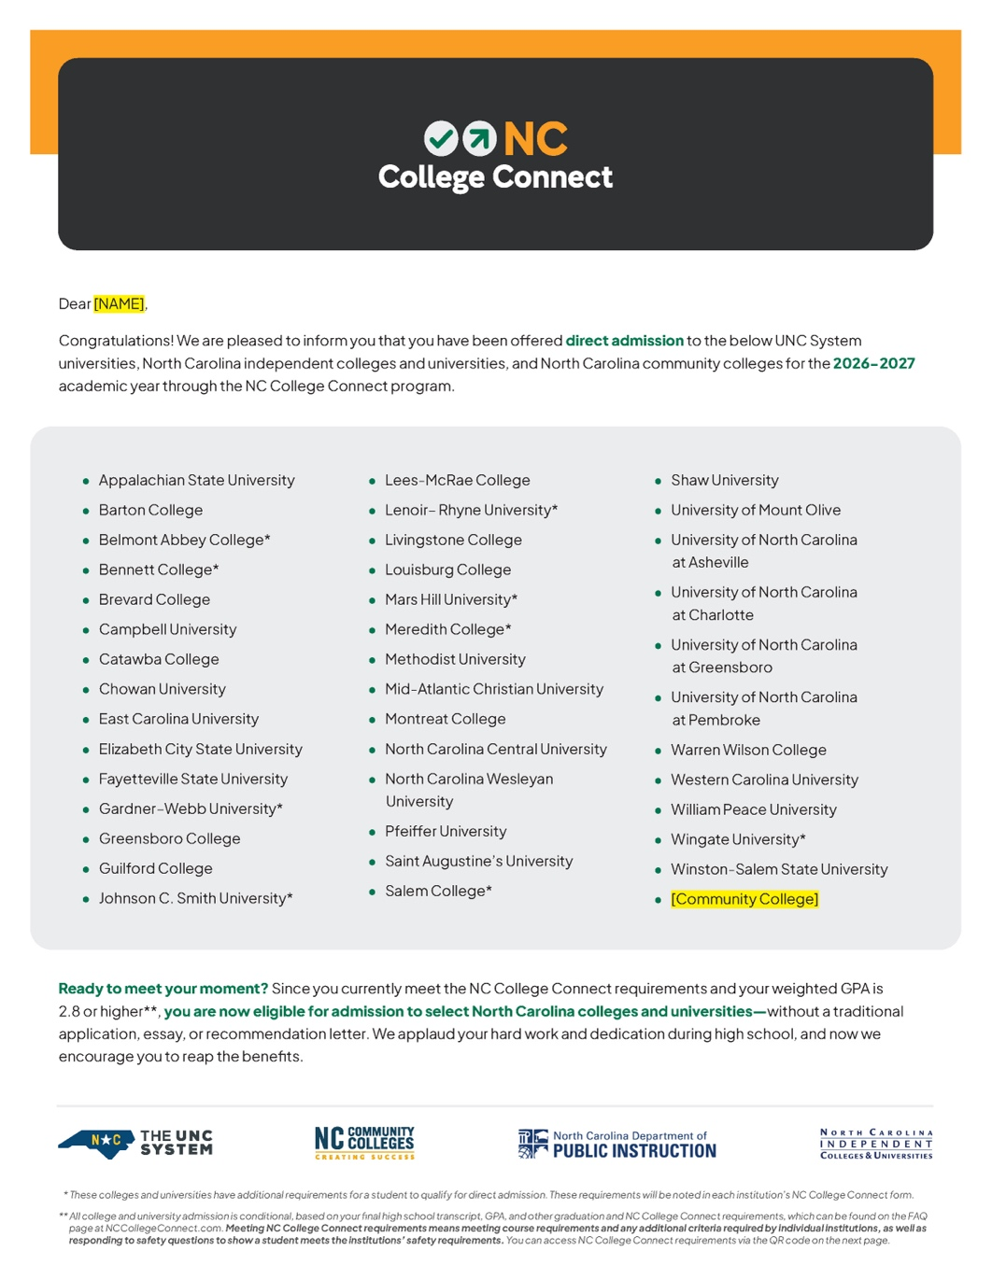
How Will Students Know They’re Eligible?
Students will be directly admitted with colleges and universities where they already meet GPA and NC College Connect requirements.
Eligible students will receive an official letter in the mail by the start of their senior school year — and can see a full list of colleges and universities where they've met NC College Connect admission requirements on NCCollegeConnect.org.
Your counselor will have a list of eligible students, too, so check with them.

Slide 6
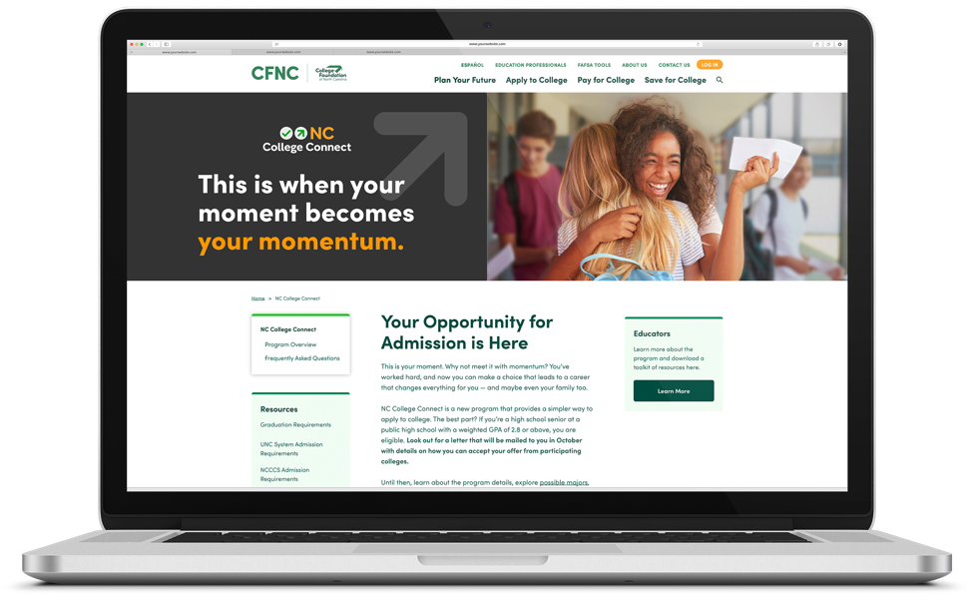
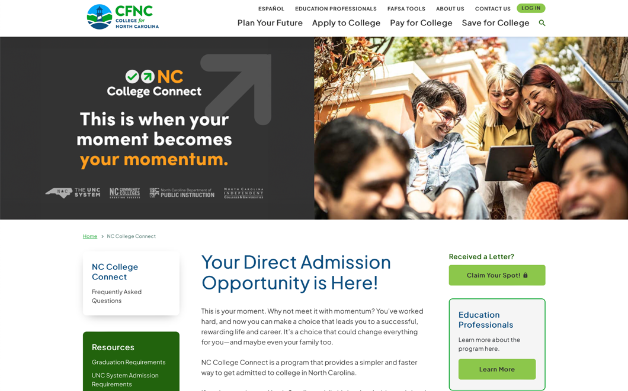
How Will Students Accept Their Admission?
Students should scan the QR code on their letter to visit NCCollegeConnect.org, where they can access the application portal.

Slide 7
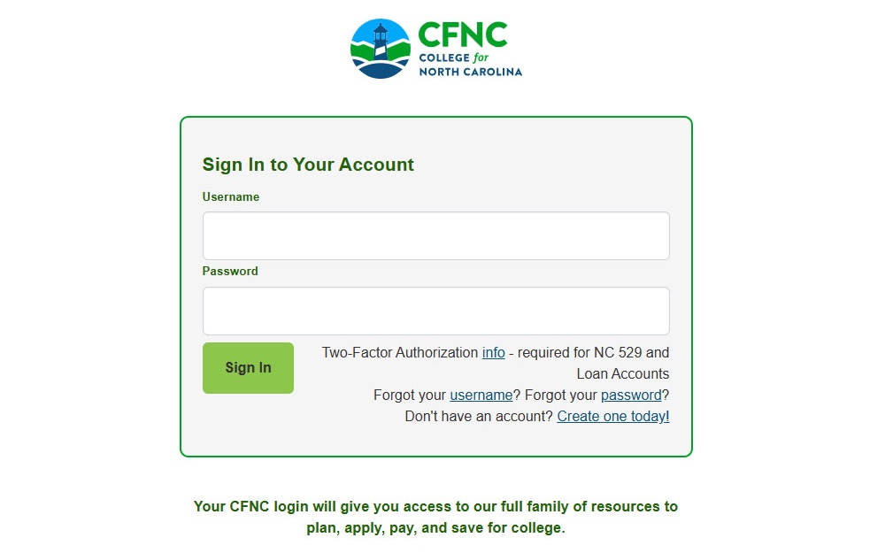
How Will Students Accept Their Admission?
On NCCollegeConnect.org, qualifying students will be directed to log into the NC College Connect portal using their existing CFNC.org account information, or they will be prompted to create a new CFNC account.​

Slide 8

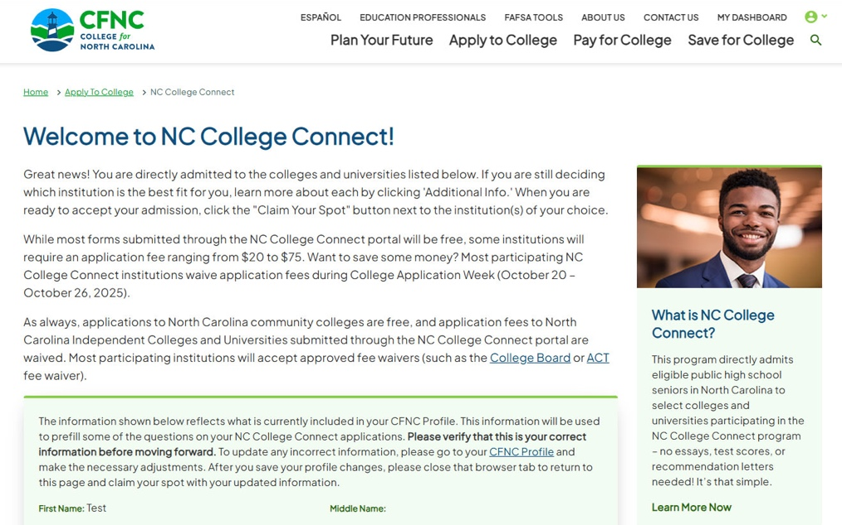
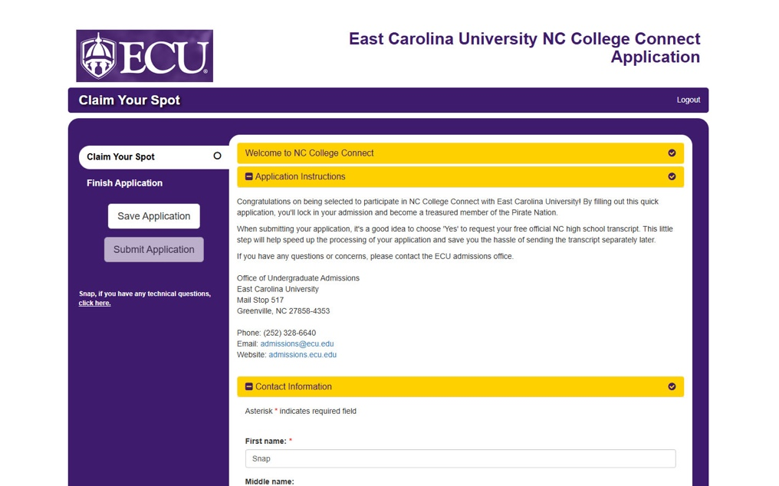
How Will Students Accept Their Admission?
After logging in, students will see a complete list of institutions where they have been offered admission. They will have the option to complete a NC College Connect form to accept their admission for each college or university of their choice.​

Slide 9
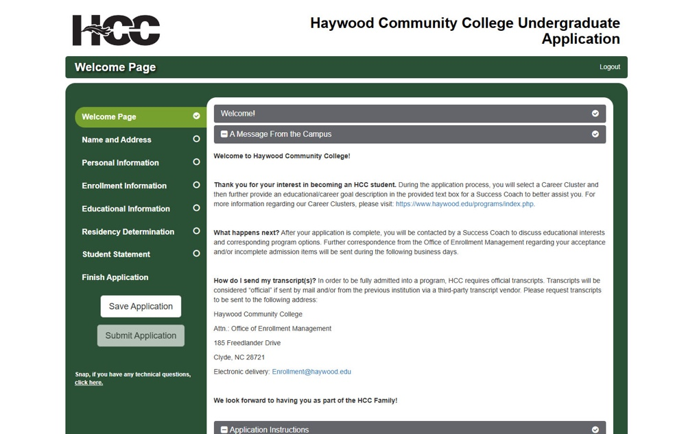
How Will Students Accept Their Admission?
For your local community college, the program will redirect to that institution’s traditional application — but don’t worry, you already meet application requirements and are already admitted! The form is quick and easy.​

Slide 10

Will There Be Application Fees?
Some NC College Connect forms submitted through the NC College Connect portal will be free. For some institutions, students will be required to pay an application fee ranging from $20 to $75 alongside their short form.
For NC College Connect forms submitted in the NC College Connect portal to North Carolina independent colleges and universities, application fees will be waived.
Applications to North Carolina community colleges are always free and most participating institutions will accept approved fee waivers (such as the College Board or ACT fee waiver).
During College Application Week (Oct. 20–26, 2025)
most application fees will be waived—
so, submit applications this October!

Slide 11

What’s Next?
After accepting admission, students will be contacted by the colleges or universities they chose with more information on financial aid, enrollment next steps, and any additional information they require.

Slide 12
Keep in Mind
Remember — during College Application Week (Oct. 20–26, 2025) most application fees will be waived. Make sure students submit their applications this October!
1
While students may qualify for direct admission to the colleges and universities that are a part of NC College Connect, students are encouraged to apply to any other North Carolina college or university they would like via CFNC.org, based on their priorities and interests. However, once students have submitted the form through NC College Connect, there is no need to submit another application to apply to the same institutions through their traditional application process or other application platform.
2
Students are encouraged to explore their financial aid options on CFNC.org, including the Next NC Scholarship, local scholarships, and other sources of federal and state aid, to make informed decisions about their future.
3

Slide 13







You Have Support
Education partners across the state are aware of the program details and are here to support you as you help students navigate their journey to college.
[Your Local CFNC Outreach Coordinator]
[Your District PIOs]
For High School-related Questions: NCCollegeConnect@dpi.nc.gov
For UNC System Questions: nccollegeconnect@northcarolina.edu
For North Carolina Independent Colleges & Universities Questions: nccollegeconnect@ncicu.org
For NCCCS Questions: nccollegeconnect@nccommunitycolleges.edu

Slide 14


Learn
More!

